Slide 1


Next-Gen Credit Risk and Fraud Detection with Explainable AI
Cheng-Min Tsai,
Nguyen-Thu Thuy,
Huei-Wen Teng
NYCU
MY SITE
20251013 Project presentation

Slide 2
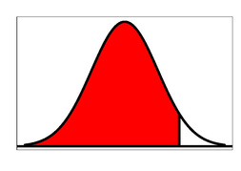
Motivation
Motivation
There is a need to redesign ML frameworks for consumer FinTech analytics with both accuracy and interpretability.
The model should capture complex data patterns across users, cards, and transactions.
It must remain transparent and trustworthy for users and regulators.
This study proposes a hybrid framework combining:
XGBoost for strong predictive power.
Decision Tree and SHAP for clear, explainable insights.
IDA Template

Slide 3
Outline
Motivation ✓
Intro Datasets
Define Credit Fraud
Clean Data
EDA Chart
Conclusion
IDA Template

Slide 4
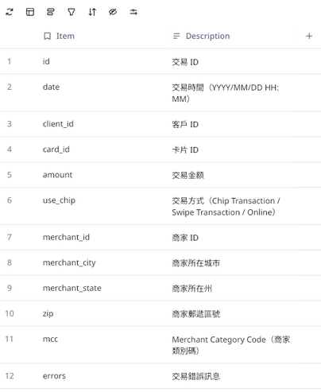
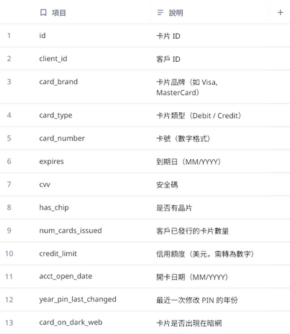
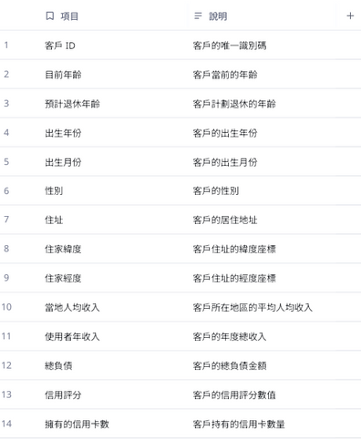
Intro Datasets
Intro Datasets
Teachers datasets on kaggle (Kaggle's Financial Transactions Dataset: Analytics, introduced by Chrissy)
Cards, Transactions, Users
Title

Slide 5
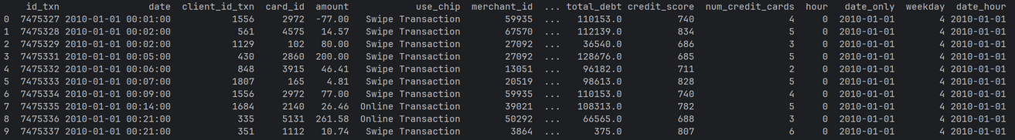
Intro Datasets
Clean the data
There datasets we use is Cards, Transactions, Users
Remove or make up the missing values
Combine three datasets
Remove unused datas (cvv, card_on_dark_web...)
Title

Slide 6
Define Credit Fraud
Define Credit Fraud
To define what situations conform to fraud.
Common situations
Low credit score
Late-night transactions ✓
Multiple transactions in a short period ✓
Spending amount significantly different from usual
Spending location too far from home
Don’t change card pin for long time
Title

Slide 7
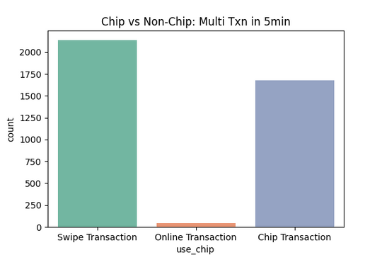
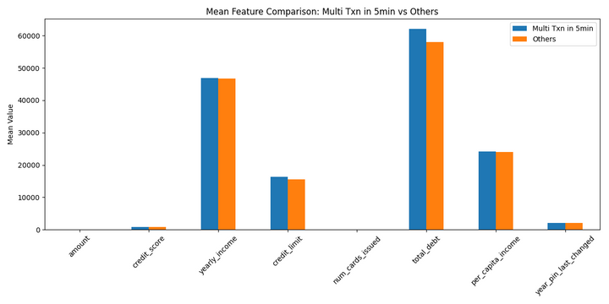
EDA Chart
EDA Chart
Frequent transactions in a short period of time (5min)
Notated these datas in Trans_Data
Measure the difference in these bias data
Title

Slide 8
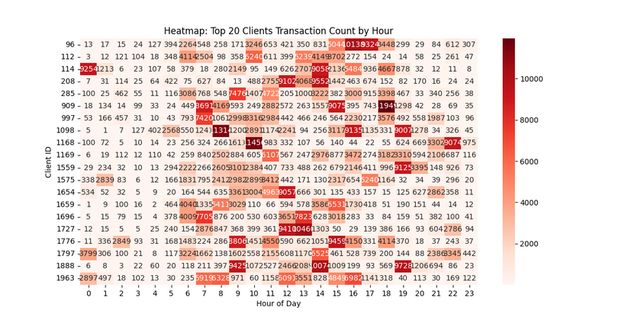
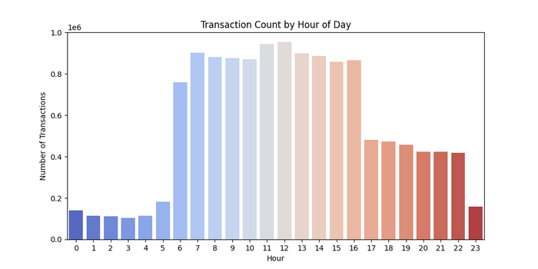
EDA Chart
EDA Chart
About transactions Time
Observe numerous amount at strange time
Client 114
Client 1168
Title

Slide 9
Conclusion
Conclusion
Transaction Distribution
Trading is concentrated between 6 AM and 4 PM.
The least activity occurs from 11 PM to 5 AM.
The risk of using a card by swiping is the higher than chip.
High transaction clients compared to low transaction clients.
higher yearly income
higher total debet
Frequent transactions data compared to others.
higher total debet
higher credit limit
Title

Slide 10
Next-Gen Credit Risk and Fraud Detection with Explainable AI
Cheng-Min Tsai,
Nguyen-Thu Thuy,
Huei-Wen Teng
NYCU
MY SITE
20251013 Project presentation

